Slide 1

Pharmaceutical Business Data Analysis
By:- Nick, Padmini, Tamala and Akshita

Slide 2
INTRODUCTION
We analyzed a Kaggle dataset on Pharmaceutical Business Data. This data consists of information about 59 countries buying various drugs during the year 2015. We are interested in revenue/sales that happened in 2015, the prediction of those sales and the per capita spending.
Tools Used Geocode API
GMaps World Bank API Facebook’s Prophet Prediction Model

Slide 3
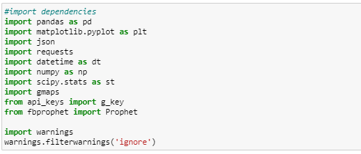
What Dependencies Did We Import?
Commands in Command Prompt

Slide 4
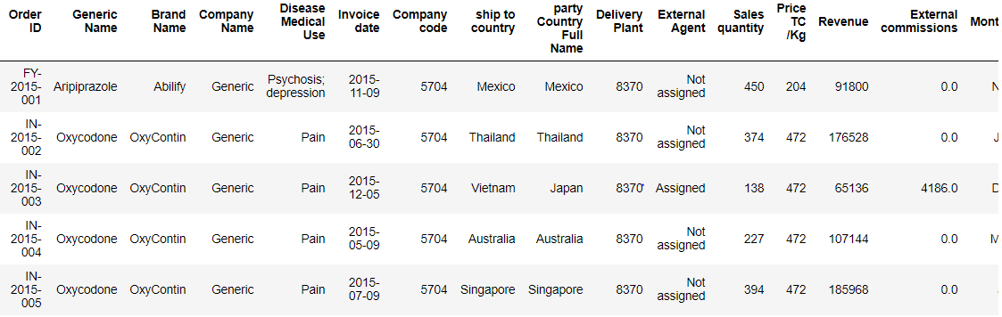
Importing the Excel File

Slide 5
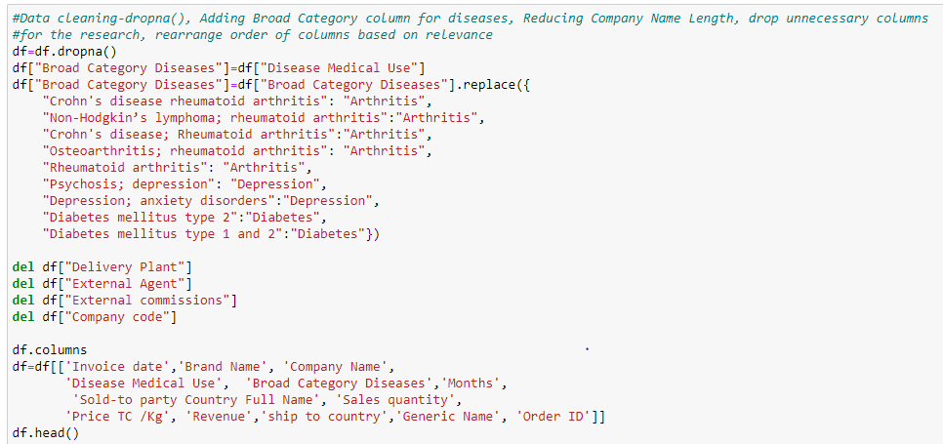
Data Cleaning

Slide 6
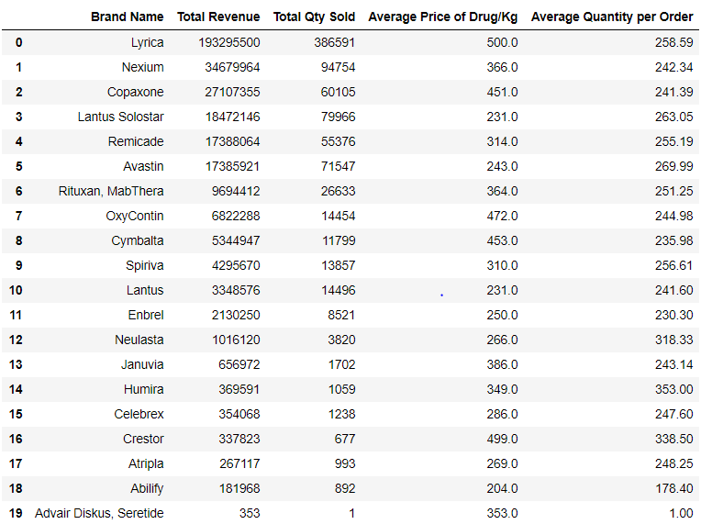
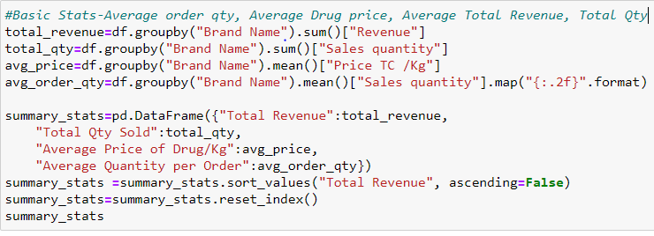
Basic Summary for each Drug

Slide 7
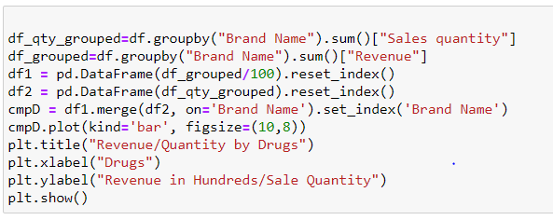
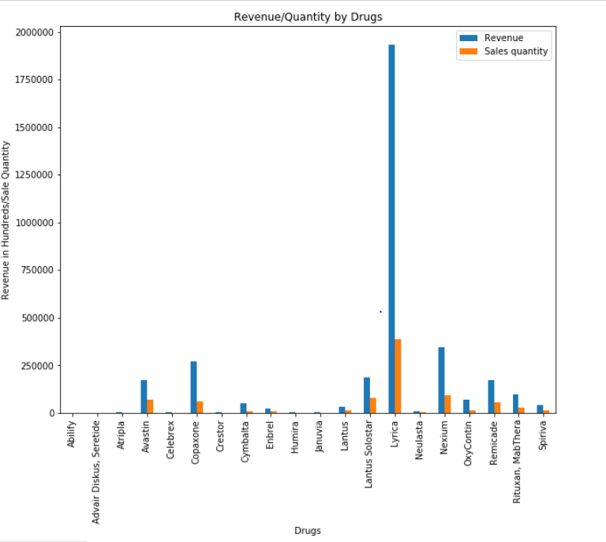
Revenue/Quantity by each Drug

Slide 8
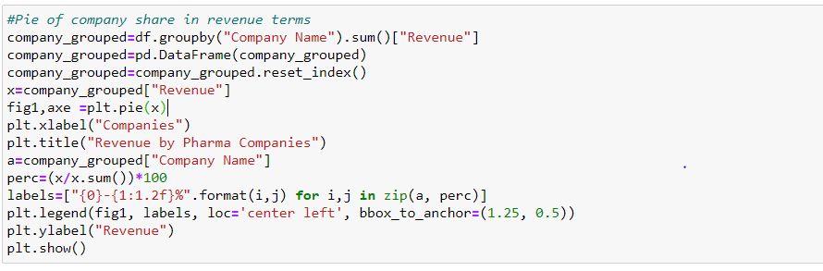
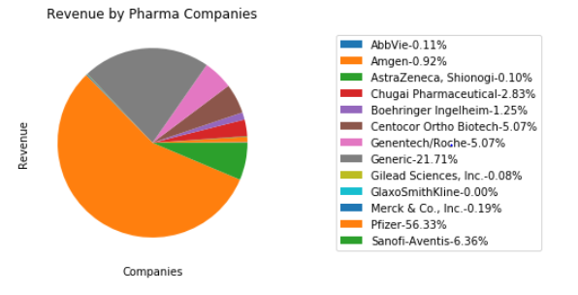
Company share in revenue

Slide 9
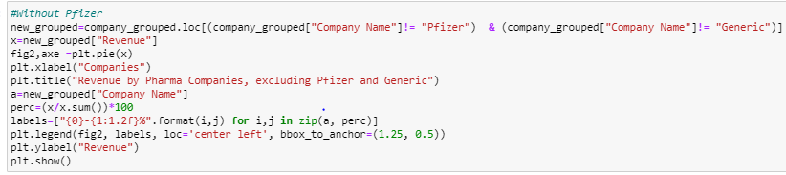
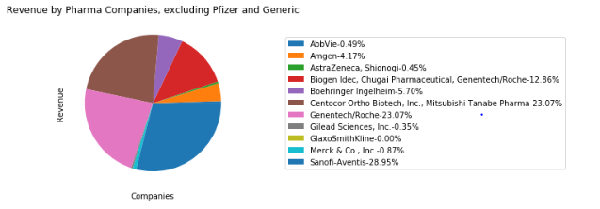
Company Share in Revenue Excluding Outlier

Slide 10
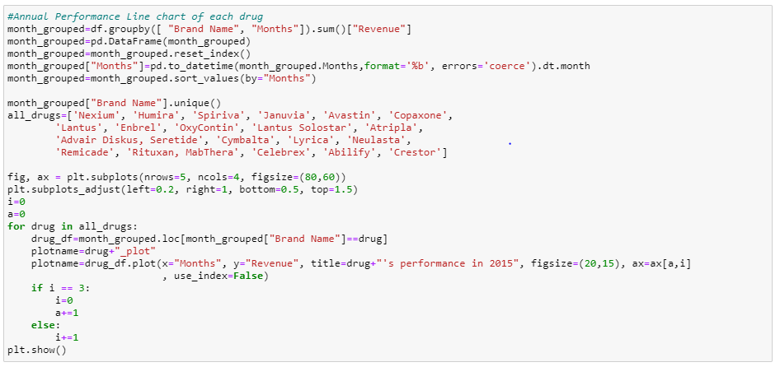
Annual Performance of each Drug

Slide 11
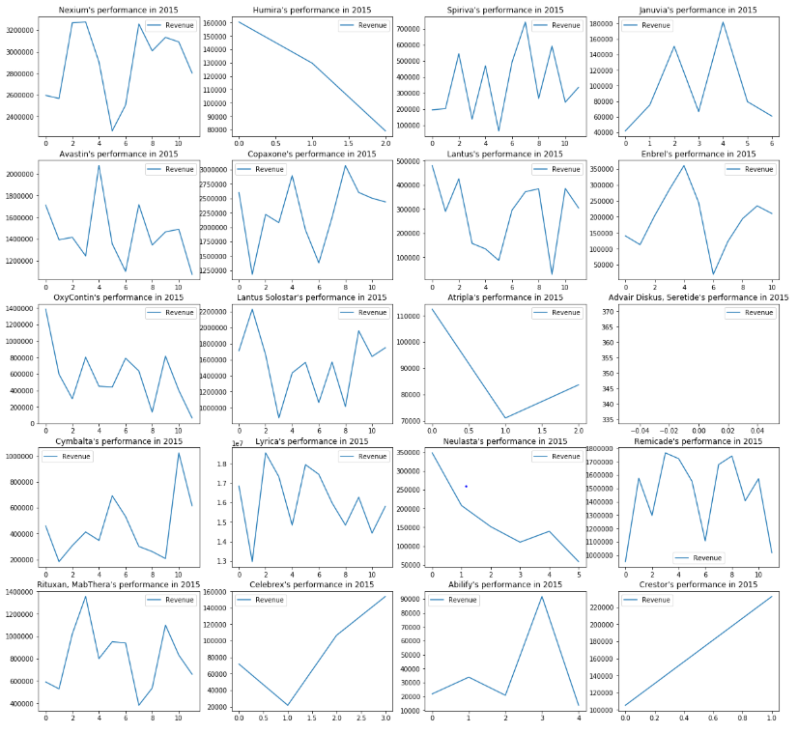

Slide 12
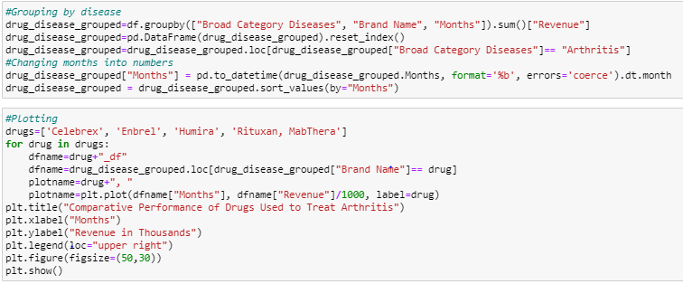
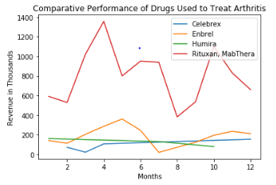
Drugs with Common Treatment Target (Arthritis)

Slide 13
Prediction and Time Series Analysis
ARIMA Model [Auto-Regressive Integrated Moving Average]
Seasonality Naïve
TBATS [Trigonometric Exponential Smoothing with Box-Cox transformation, ARMA errors, Trend and Seasonal Components]
ETS [Error, Trend, Seasonal]
Prophet

Slide 14
Facebook's Prophet Model for Prediction
Prophet model is a non-linear model for Time series analysis to forecast data based on past records.
As noticed commonly in major business analysis, the model incorporates for the effects of :
Weekly/Yearly Cycle [Seasonality Effect]
Holiday Effect
Trend Change (Non periodic) [E.g.:- effect of getting outdated]
Outliers
Assumptions in the Prediction
The trend that we saw in 2015, same shall continue for the coming year.
There’s no seasonality effect or trend effect (because we aren’t aware of it)

Slide 15
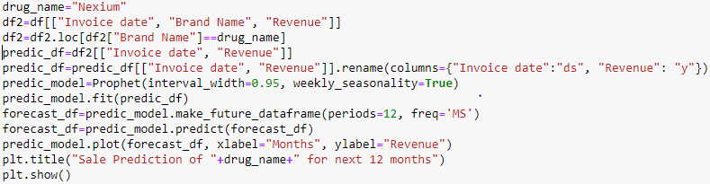
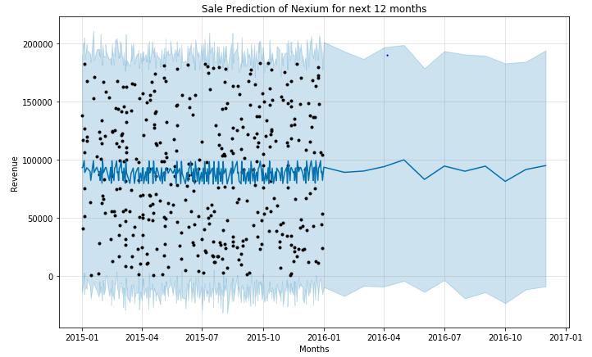
Prediction of Next Year’s Sales for a Drug

Slide 16
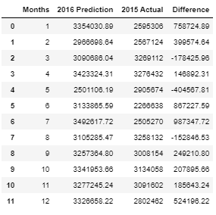
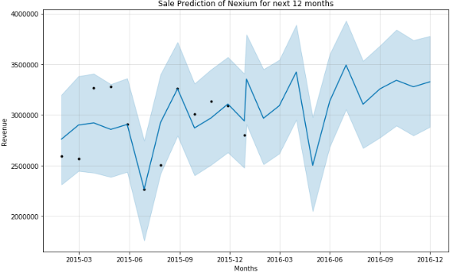
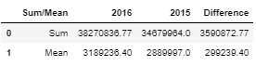
Grouped by Month Forecast

Slide 17
Pharmaceutical companies in United States selling Brand name drugs to 59 Countries.

Slide 18
The spread comparisons of the top 5 countries was based on per line item. The results show that Indonesia bought more items during 2015.

Slide 19
Top four countries product breakdown based on Revenue other than India

Slide 20
Revenue based on drug brand name shows Lyrica is best offshore drug.

Slide 21
Revenue based Pie chart for each country shows India 58% with $193 million revenue on the top.

Slide 22
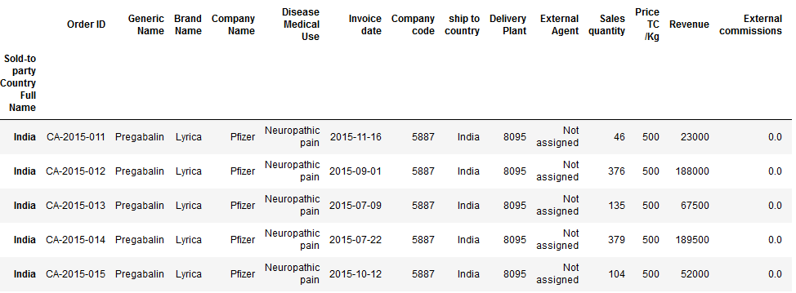
Further Details about Revenue Generated from Sales to India

Slide 23
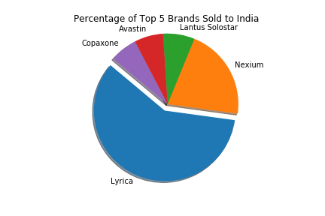
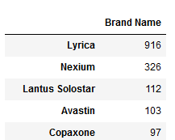
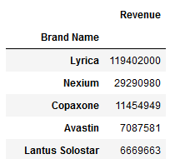
The Most Bought Pharmaceutical Drug in India
Dataframe Comparison of Number of Orders and Revenue of Brand Name Drugs

Slide 24
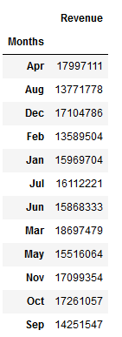
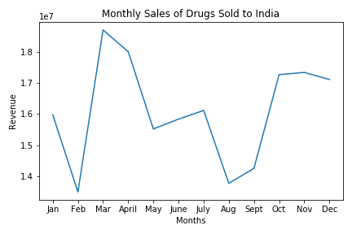
Overall Monthly Sales of Pharmaceutical Drugs Sold to India

Slide 25
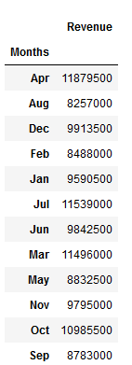
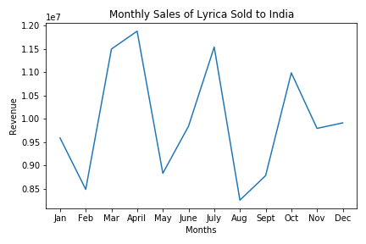
Monthly Sales of Lyrica Sold to India

Slide 26
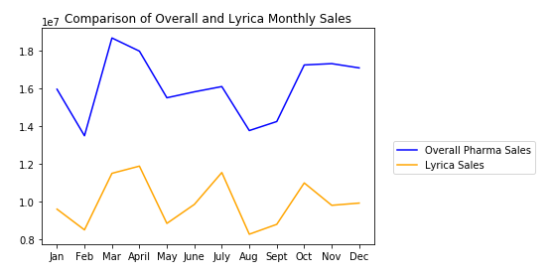
Potential Relationship that Lyrica Influences the Overall Pharmaceutical Sales in India

Slide 27
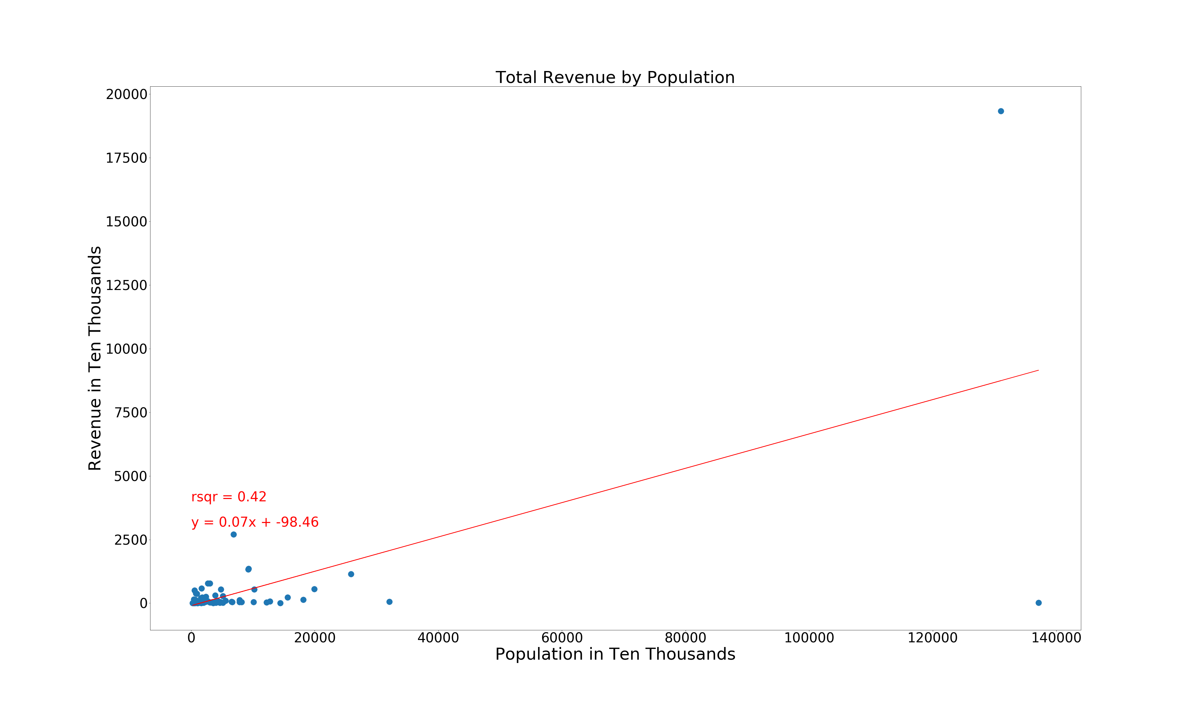
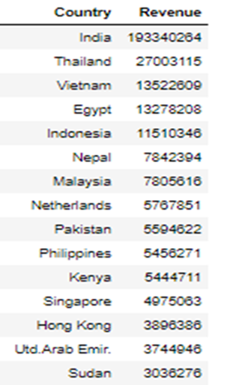

Slide 28
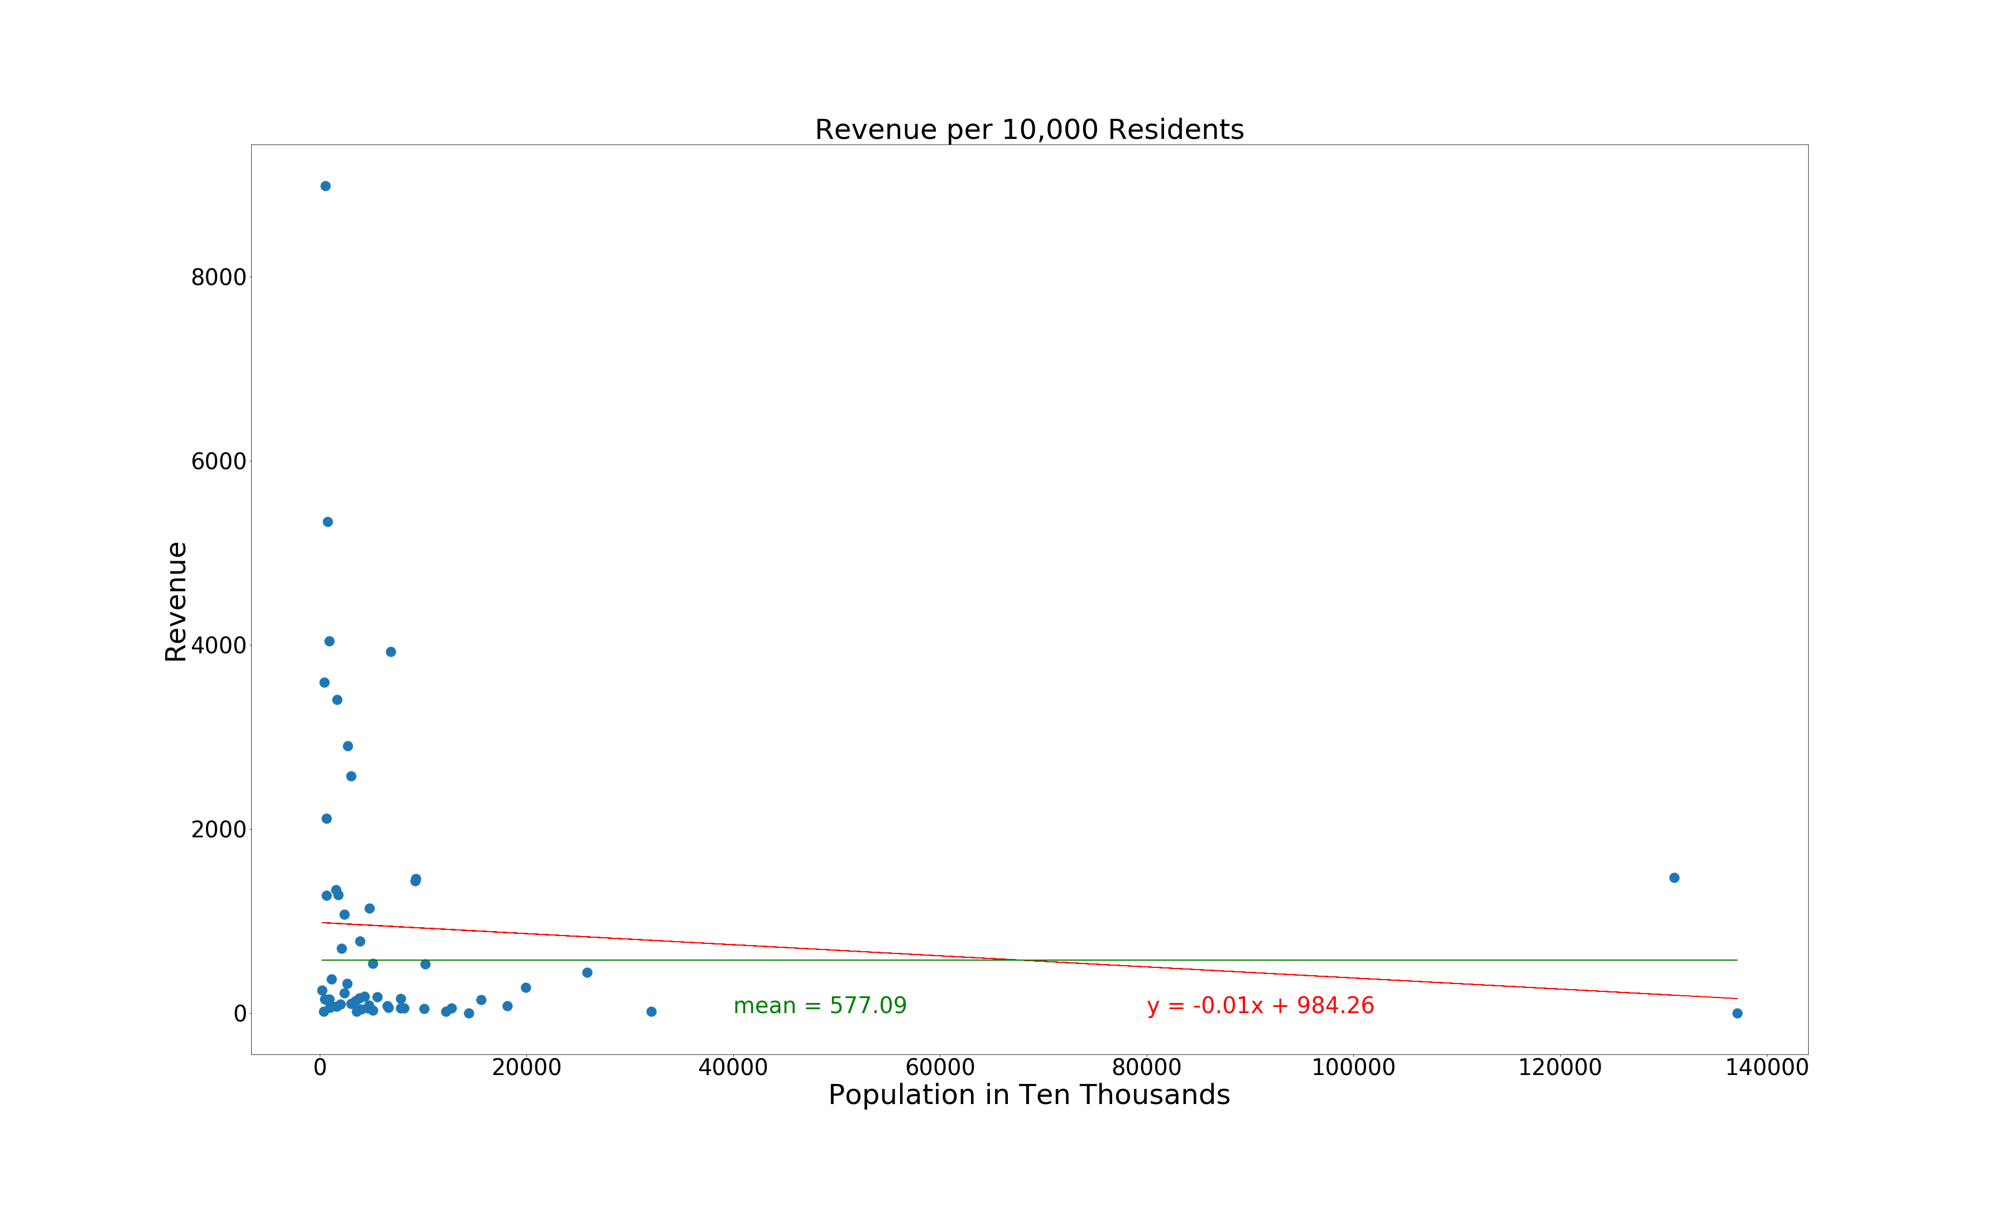
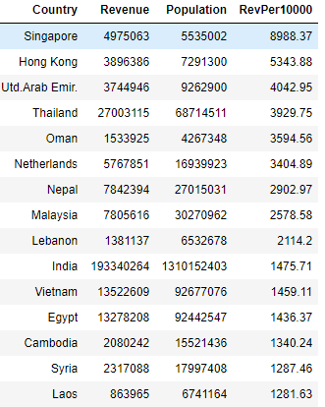
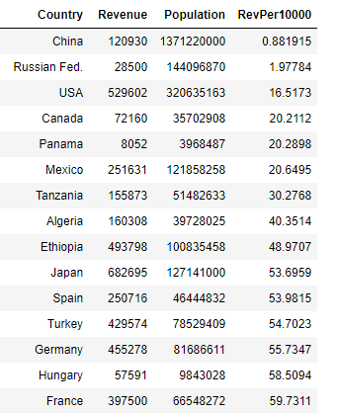
Highest Per Capita Revenue
Lowest Per Capita Revenue

Slide 29
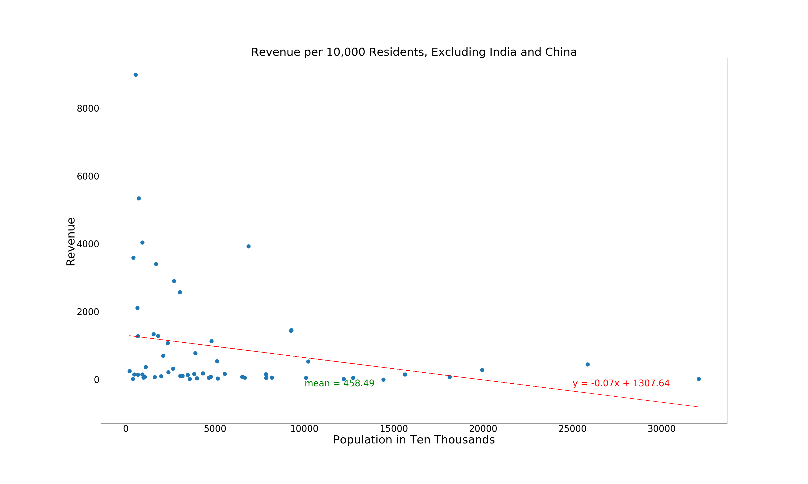
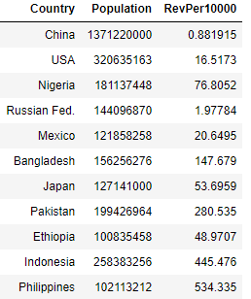
Countries To Target

Slide 30
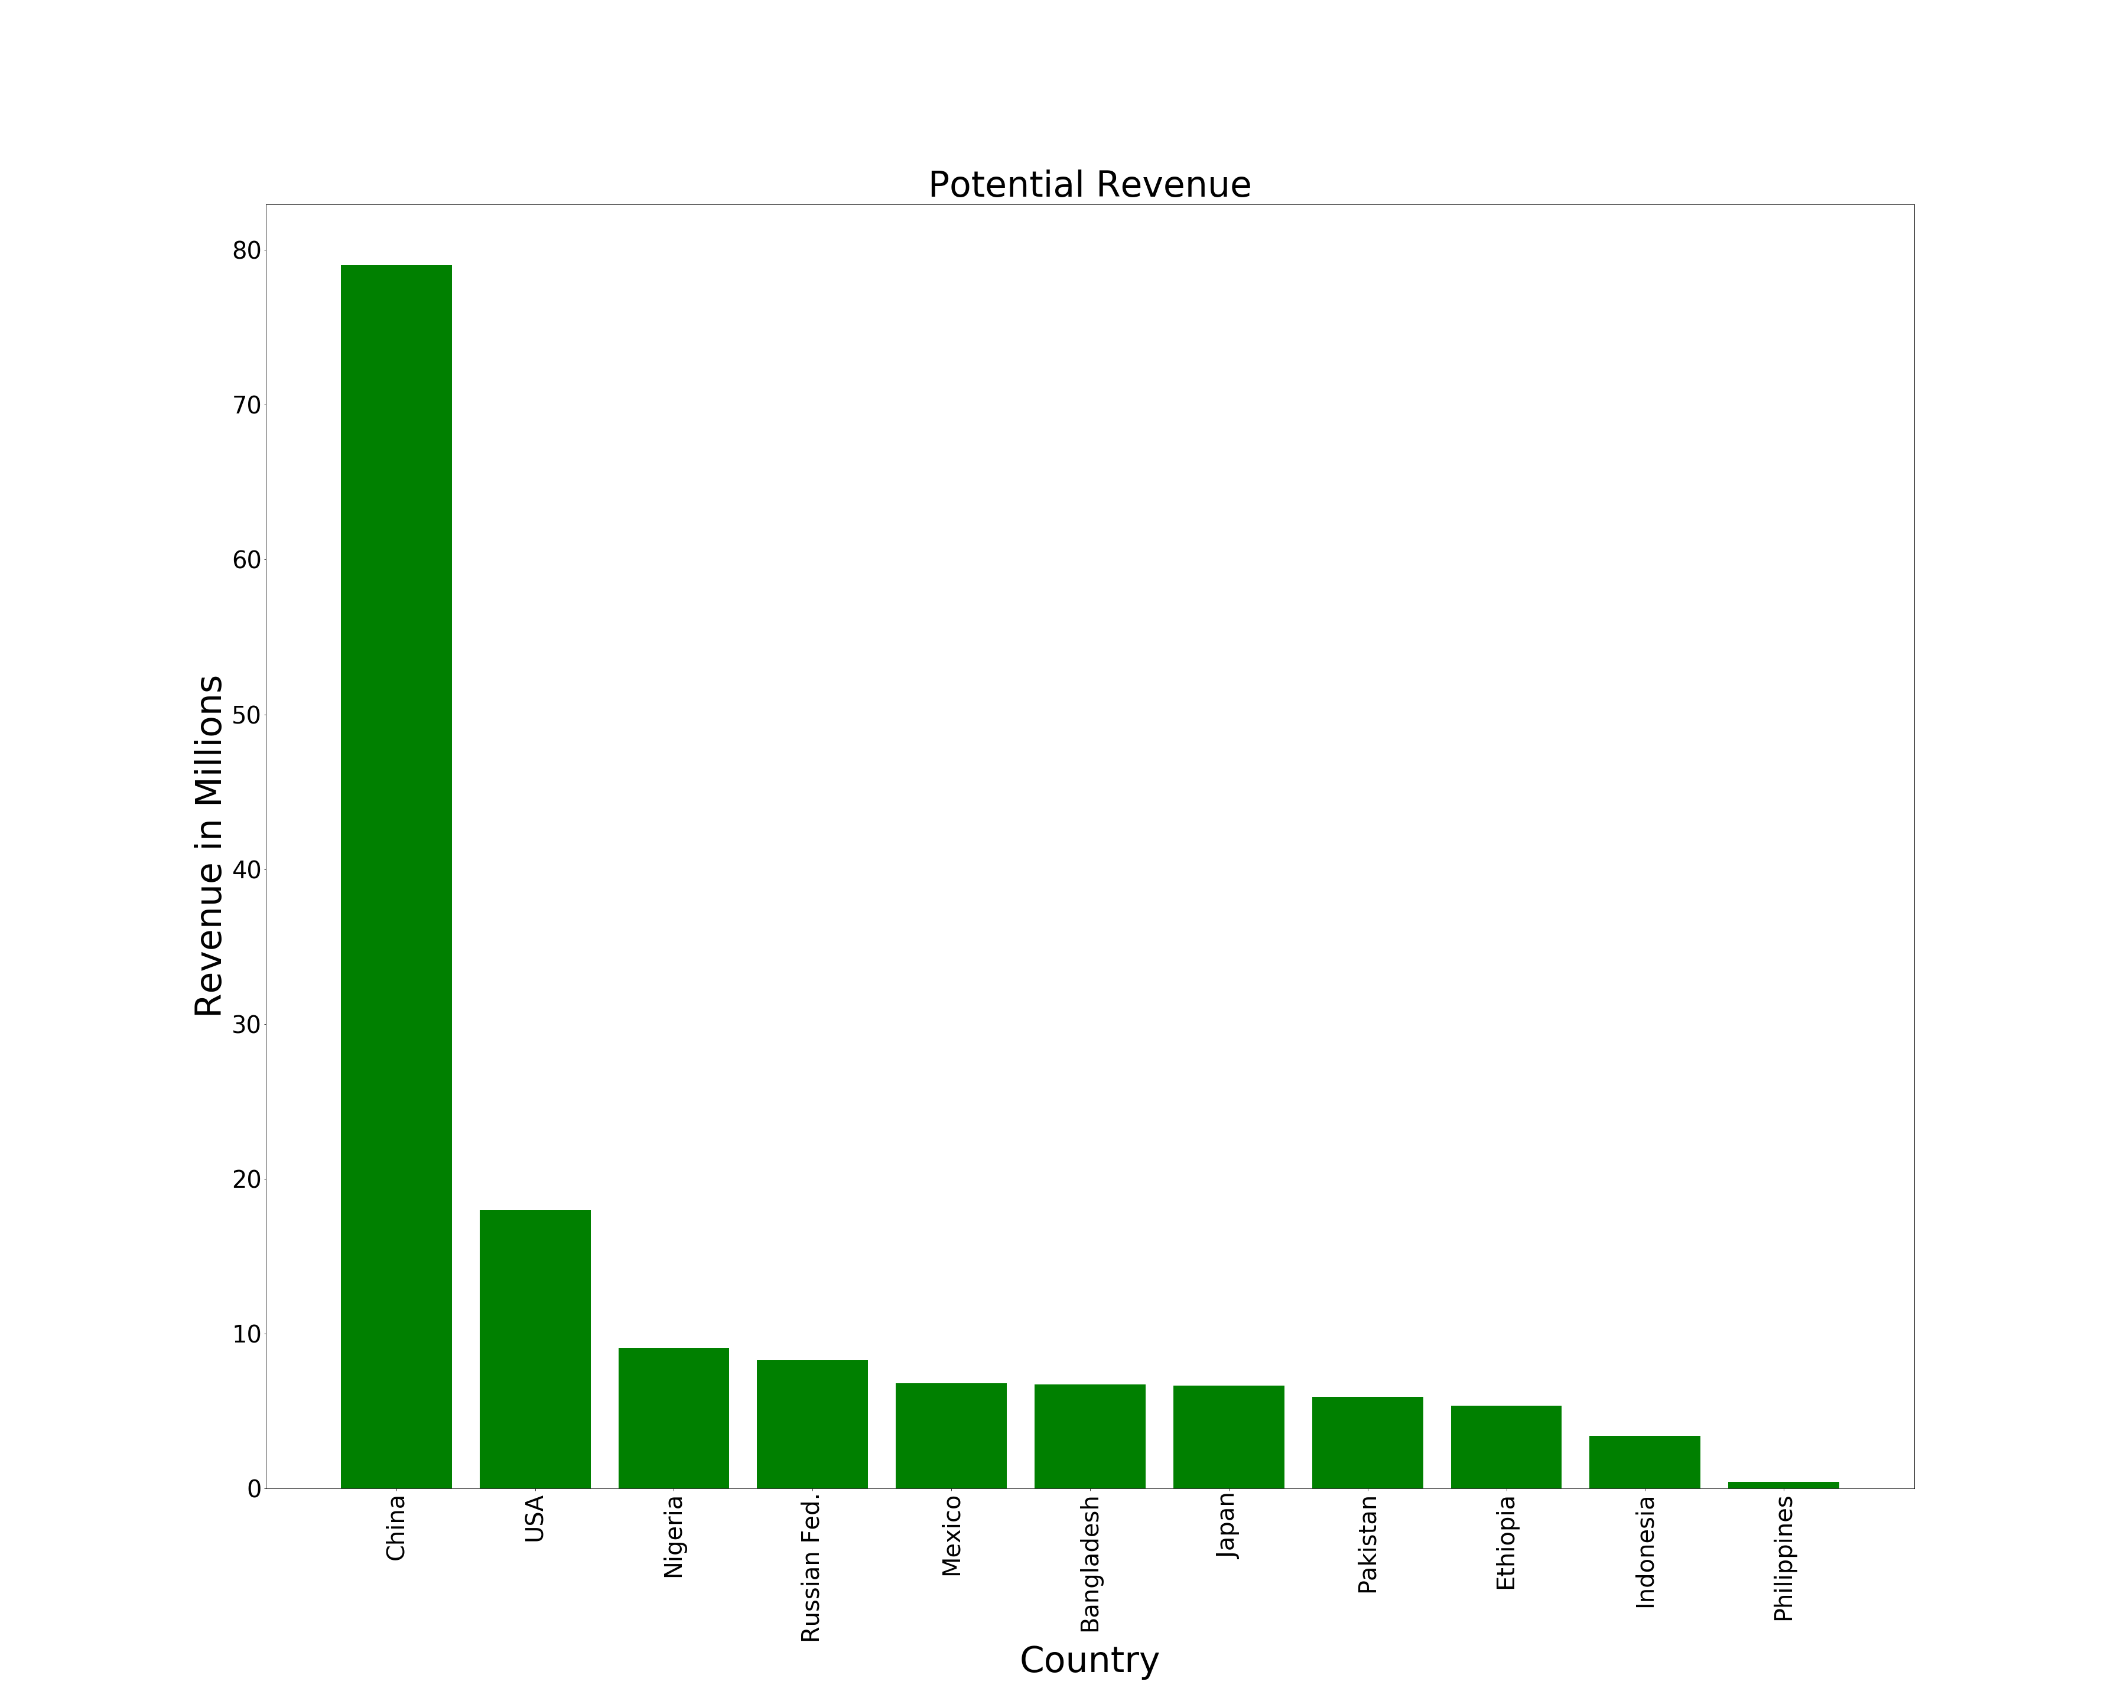

Slide 31
Conclusions
Pfizer’s Lyrica
56.3% of Total Revenue
Sold in 37 Countries
India is Top Importer
58% of Total Revenue
The Prediction model forecasts
9.38% increase in Revenue for “Nexium” in 2016
Per Capita Differed From Total Revenue
India Highest Total Revenue – 10th Per Capita
Singapore Highest Per Capita – 12th Total Revenue
Limitations
Political Impacts |Trade Policies | Sanctions | Domestic Availability | National Holidays | No Kaggle Summary

Slide 32
Thank You!!
Questions?

